Slide 1
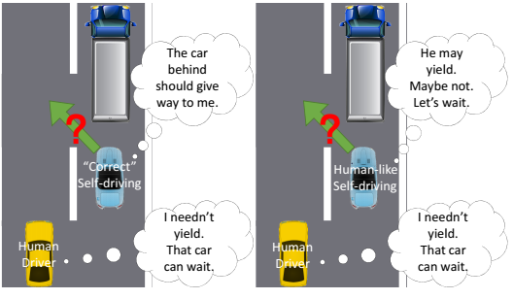
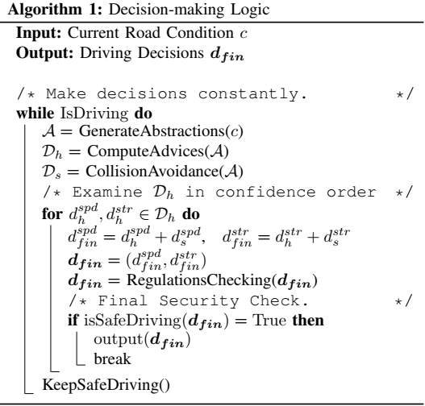
Human-Like Driving: Empirical Decision-Making System for Autonomous Vehicles
Proposition:
Implement a human-like drivng system to give autonomous vehicles the ability to make decision like humans in order to solve the problem of avoidable accidents faced bu autonomous vehicles during tests.
Methodology:
A CNN model is used to get information from the road scene, then a decision-making system is calculates the exact commands to control the vehicle based on the abstractions.
Future works:
- Develop a more efficient optimization method to decrease the time cost of the training process.
- Extract some information from RGB data, even when it is incomplete and unstable. It can be a useful supplement.
[Tags: machine learning, collision avoidance, self-driving, vehicle-control, autonomous vehicles]

Slide 2
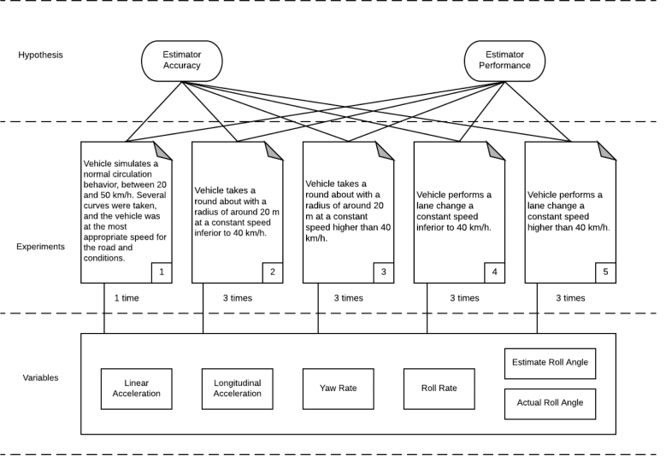
Design of Low-Cost Vehicle Roll Angle Estimator Based on Kalman Filters and an IoT Architecture
Proposition:
Integrate low-cost roll angle estimators based on Linear and unscented Kalman filters. Evaluate the precision of results obtained and also embed this kind of estimators in IoT architectures. Then deploy them in vehicles.
Methodology:
Hardware components used include: A van, GPS dual antenna, Raspberry Pi 3, intel Edison, IMU and a Vbox. Software was implemented in C++.
Possible/Future works:
- More complex estimators combining kalman filters, NN and other techniques such as deep learning can provide better results.
Defined experiments
[Tags: roll angle estimators, kalman filters, IoT Architecture, low-cost]

Slide 3
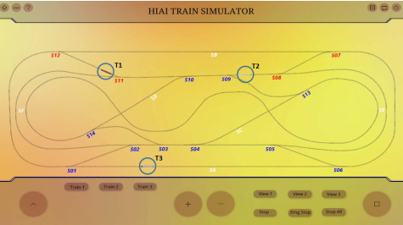
Optimal Trajectory and Schedule Planning for Autonomous Guided Vehicles in Flexible Manufacturing System
Proposition:
In their research, the proposed an algorithm to solve the trajectory planning and collision avoidance challenges in the domain of autonomous transportation systems.
Methodology:
A modified Dijkstra’s algorithm was used on a custom graph with quite a number of autonomous vehicles: tracks, trains… in the test bed.
Future works / possible improvements:
- In the experiments, constant speed was assumed for all the vehicles: for a test bed designed to be as realistic as possible, variable speed should be put into consideration. It can be dealt with by considering it as an optimization problem and apply local search algorithms + finding best solution based on a heuristic cost function
- Provide more numeric comparisons and verification against other algorithms in similar studies.
Simulation with 3 Agents
[Tags: optional trajectory planning, dijkstra’s algorithm, guided vehicles]

